Slide 1

Notes:
Opening & Hook: Good morning/afternoon, everyone. Today, we are peering beneath the surface of traditional finance to examine the hidden plumbing that dictates the global economy. Most investors spend their time looking at traditional economic signals—quarterly earnings, interest rate announcements from central banks, or retail inflation figures. But what if I told you that the mechanics governing markets today have almost nothing to do with textbook interest rates and everything to do with collateral, money supply growth, and stealth refinancing?
Core Thesis: The main message of this presentation is simple yet critical: the global economy has accumulated a structural debt burden so vast that it can no longer survive without continuous, extreme monetary debasement. This is not a short-term policy mistake; it is a mathematical imperative.
The Structural Shift: Over the past few decades, the entire financial paradigm has flipped. Financial markets are no longer primary engines for raising new capital to fund future innovation; they have transformed into massive debt refinancing machines. Because governments and corporations cannot afford to default without triggering a catastrophic collapse of the global financial architecture, policymakers are forced to print money and expand liquidity continuously.
Takeaway: Today, we will break down why this structural shift occurred, how short-term debt and stealth quantitative easing (QE) are fueling monetary inflation, why traditional asset classes like bonds and passive equity funds leave you vulnerable, and how a strategic, asymmetrical allocation to hard assets—specifically Gold and Bitcoin—provides the mathematical defense required to preserve wealth. Let’s dive in.
Michael Howell: FED Rate Hikes Will Trigger The Biggest Bull Run Ever
https://www.youtube.com/watch?v=YlriydGLMPg

Slide 2

Notes:
Overview: To understand why sovereign debt is expanding exponentially, we have to look at the three unstoppable macroeconomic forces that are trapping Western economies today.
Pillar 1 — Aging Demographics: In the West and developed nations, we are facing an escalating dependency ratio. The population is aging rapidly. No politician, regardless of party, has the political leverage to cut pensions, healthcare, or social security benefits without facing immediate political suicide. As entitlement commitments balloon, mandatory government spending rises automatically year after year.
Pillar 2 — Capital Wars & Defense Spending: We have transitioned into an era of global geopolitical conflict and trade friction. Tensions between major superpowers—namely the US and China, alongside military rearmament across Europe and Asia—demand continuous, massive defense and industrial spending. In a world of escalating multipolar friction, turning to fiscal austerity would be considered a strategic blunder. This concept of "Military Keynesianism" ensures that government expenditures remain elevated permanently.
Pillar 3 — The Debt Overhang & Fiscal Deficits: Look at the numbers: the US economy is running a structural fiscal deficit of roughly 6% of GDP year after year. This is happening during periods of economic expansion, not just deep recessions. Running a 6% deficit perpetually guarantees an exponential accumulation of total debt.
The Pressure Point & Takeaway: The traditional tax base is completely squeezed out; governments cannot tax their way out of this shortfall without crushing economic growth. When faced with huge debt commitments and limited revenue, governments face two choices: explicit default or money printing. Because default would vaporize the global banking system, money printing is the only option that will ever be chosen.

Slide 3
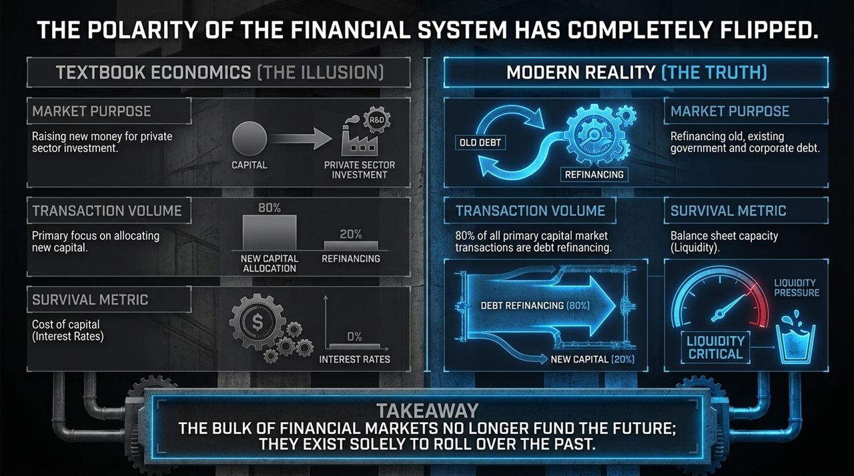
Notes:
The Contrast: If you open a standard university economics textbook, it presents a neat, logical vision of how financial markets function. Let’s call this "The Illusion" vs. "The Modern Reality".
Textbook Economics (The Illusion):
Market Purpose: Markets exist to raise new capital from investors and funnel it into private sector growth, R&D, and real economic productivity.
Transaction Volume: Textbooks assume 80% of market activity is allocated toward funding new productive capital, with only 20% dedicated to secondary market operations or refinancing existing obligations.
Survival Metric: The central metric is the cost of capital—i.e., interest rates set by central banks. High interest rates slow down borrowing; low rates stimulate it.
Modern Reality (The Truth):
Market Purpose: In reality, capital markets have become refinancing vehicles designed to roll over existing government, corporate, and household debt.
Transaction Volume: The numbers have completely inverted. Today, roughly 80% of all primary capital market transactions are debt refinancing, leaving only 20% for new capital allocation.
Survival Metric: The cost of capital (interest rates) is secondary; the primary survival metric is balance sheet capacity and liquidity. When you must roll over debt to avoid insolvency, you care far less about whether the interest rate is 3% or 5%; you care whether there is sufficient lending capacity in the financial system to extend the debt.
Takeaway: The bulk of modern financial markets no longer exist to fund the future; their primary function is to roll over the promises of the past.

Slide 4
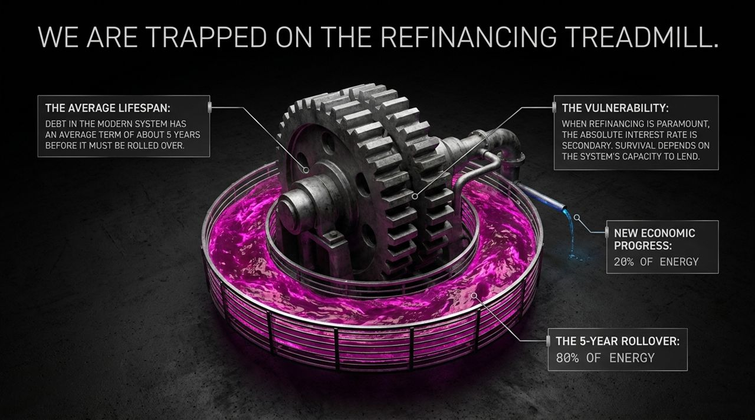
Notes:
The 5-Year Rollover Cycle: Why is refinancing so relentless? Modern debt carries an average maturity lifespan of roughly 5 years before it must be rolled over. This creates a perpetual 5-year refinancing treadmill. Every single year, a massive tranche of corporate debt, commercial real estate loans, and sovereign debt matures and demands renewal.
Energy Allocation: Think of modern financial market capacity as an energy budget. 80% of total financial energy in the system is burnt simply maintaining the status quo—rolling over the past—while only 20% goes toward new economic progress.
Systemic Vulnerability: This constant need to refinance creates immense structural fragility. If liquidity dries up in money markets for even a brief period, borrowers cannot roll over their liabilities, sparking a wave of defaults and credit freezes. Central banks understand this. They know that preventing a refinancing freeze is their ultimate priority.
Absolute vs. Relative Rates: This reinforces why central banks cannot keep interest rates restrictive for long without providing compensating liquidity. In a debt-saturated system, absolute interest rates take a backseat to system-wide lending capacity. If the plumbing stops flowing, the entire superstructure collapses.

Slide 5
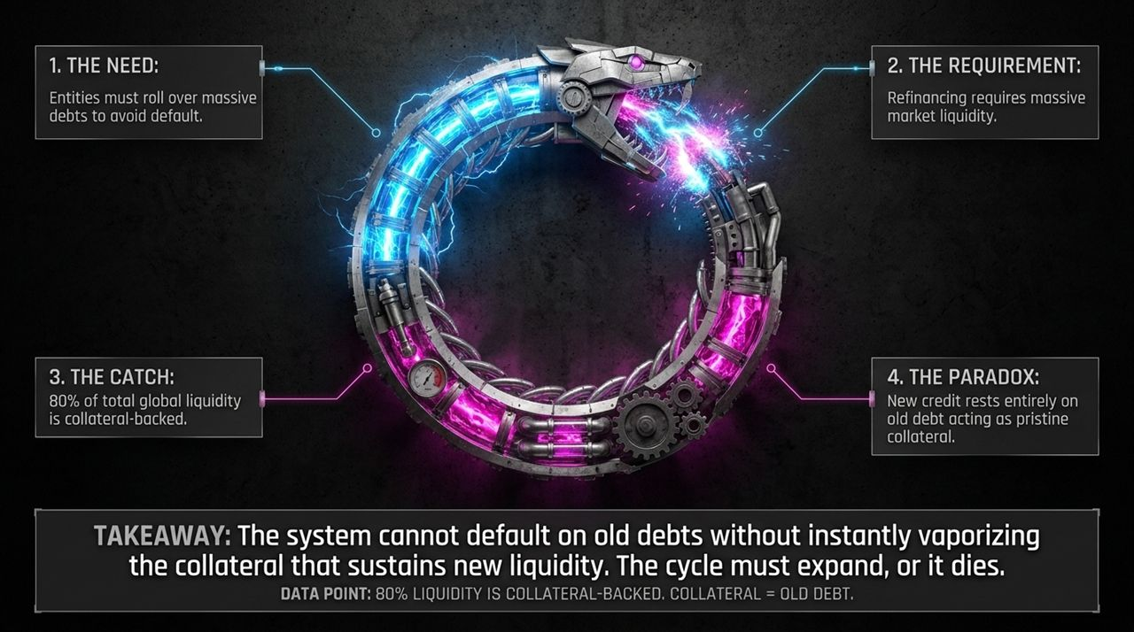
Notes:
Visualizing the Loop: This graphic represents the self-referential, inescapable cycle at the heart of our monetary architecture: the Ouroboros—a snake eating its own tail. Let's walk through the four steps of this paradox:
1. The Need: Sovereign entities, corporations, and financial institutions must continuously roll over trillions in debt to avoid immediate default.
2. The Requirement: Rolling over debt smoothly at scale requires massive, uninterrupted global market liquidity.
3. The Catch: Roughly 80% of total global liquidity is collateral-backed. Liquidity isn't just money floating around in accounts; it is credit created via repo markets, which require high-quality collateral—primarily government bonds—to secure the loans.
4. The Paradox: New credit rests entirely on old debt acting as pristine collateral.
The Systemic Dilemma: Notice the catch-22: To generate new liquidity, the financial system needs old debt to remain valuable and secure as collateral. If central banks or governments allow old debt to default or plummet severely in price, the collateral base vaporizes. A loss of collateral instantly destroys the system's capacity to create new liquidity, triggering a global credit freeze.
Takeaway: The system cannot afford to default on old debts without destroying the collateral base that generates new liquidity. The money supply must continually expand, or the entire apparatus starves.

Slide 6

Notes:
Mechanics of Stealth Money Printing: When people think of money printing, they imagine the Federal Reserve announcing official Quantitative Easing (QE)—buying long-term bonds outright. But today, money printing is occurring through a subtle, stealth mechanism led by the US Treasury.
The Long-Term Bond Trap: If the US Treasury attempted to fund its massive annual deficits by issuing huge volumes of 10-year or 30-year long-dated bonds, private bond markets would be overwhelmed. Long-term yields would spike to unsustainable levels, driving up borrowing costs for everyone and threatening financial stability.
The Treasury Bypass: To avoid crashing the long end of the bond market, the Treasury shifted its funding strategy. Instead of long-term bonds, it began issuing vast quantities of short-term Treasury Bills (3 to 6-month T-Bills). Short-term T-Bill issuance has grown to represent nearly a quarter to a third of total debt issuance.
The M2 Expansion Result: Commercial banks and money market funds absorb these T-Bills. When commercial banks purchase short-term government debt, bank balance sheets expand directly, expanding the broader money supply (M2). This is "Treasury QE." It bypasses standard central bank announcements while directly injecting monetary liquidity into the system.

Slide 7
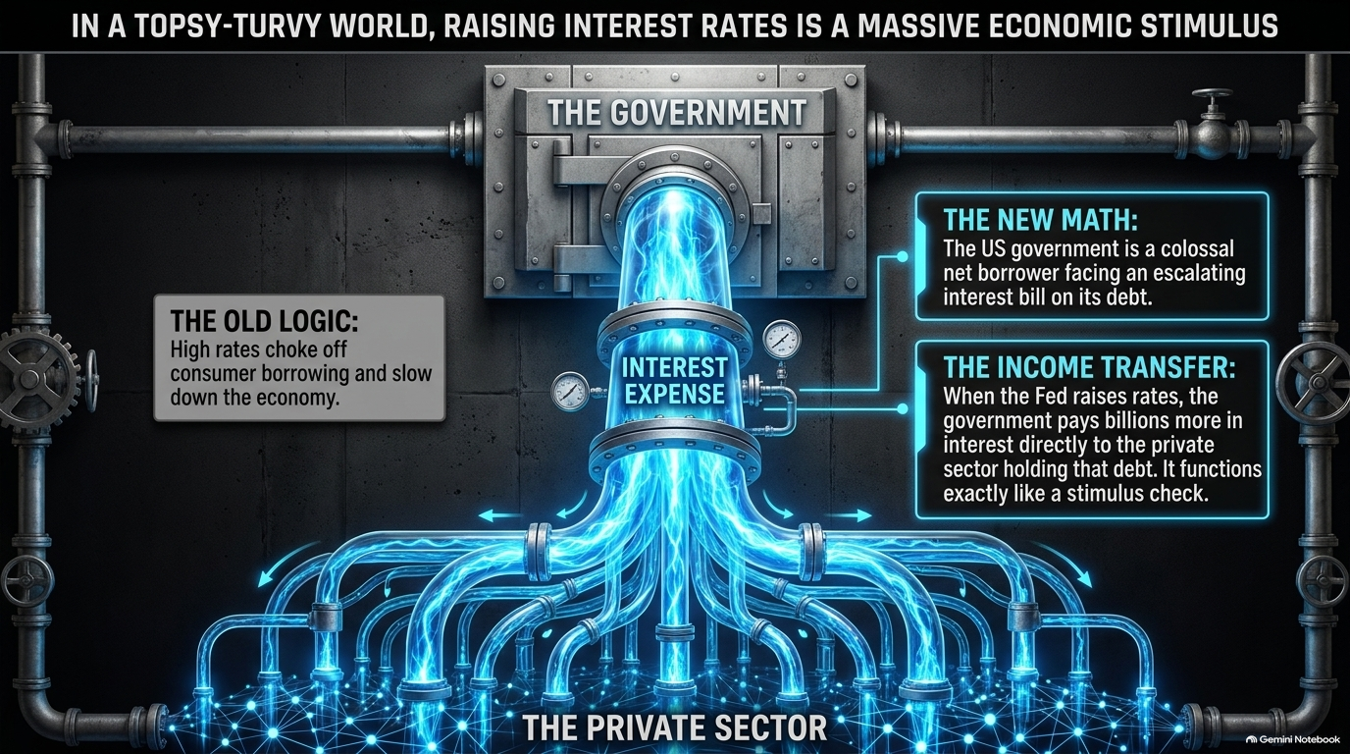
Notes:
Counter-Intuitive Reality: Here is one of the most counter-intuitive dynamics in modern macroeconomics: in today's debt-saturated environment, high central bank interest rates actually operate as a massive fiscal stimulus.
The Old Logic: Traditional monetary theory states that when the Fed raises interest rates, borrowing becomes expensive, consumer spending slows down, corporate investment drops, and the economy cools.
The New Math: Today, the government is the single largest net borrower in the economy, holding over $34+ trillion in total debt. As interest rates rise, the interest bill paid by the government escalates rapidly.
The Income Transfer Mechanism: Who receives these massive interest payments? The private sector—investors, commercial banks, money market funds, and holders of US debt. When the Fed raises rates, the US Treasury transfers hundreds of billions of dollars directly into private-sector hands via interest payments.
Stimulus Check Function: This massive cash injection acts exactly like a ongoing government stimulus check sent to holders of capital. The polarity of monetary policy has flipped: raising interest rates pumps liquidity back into the private sector, supporting economic nominal growth and requiring even more debt issuance to fund the payment.

Slide 8
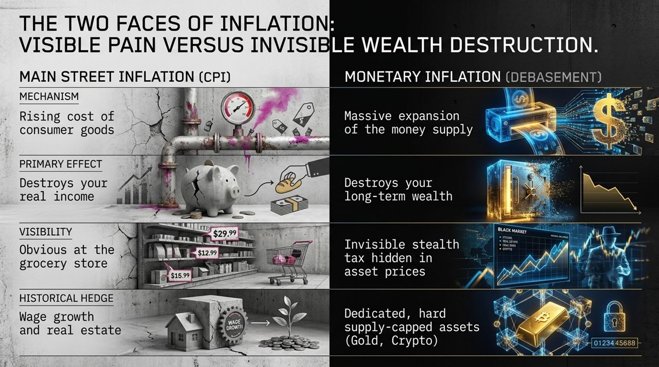
Notes:
Distinguishing Two Concepts: To protect capital, investors must distinguish between two completely different types of inflation.
1. Main Street Inflation (CPI):
Mechanism: Driven by rising prices for everyday consumer goods, energy, and services.
Primary Effect: Destroys real consumer purchasing power and squeezes wage earners.
Visibility: Highly obvious at the grocery store, gas station, and housing market.
Traditional Hedges: Traditionally hedged by wage growth, real estate, or general equities.
2. Monetary Inflation (Debasement):
Mechanism: The massive, continuous expansion of the overall money supply and credit in the system.
Primary Effect: Destroys long-term stored wealth and the purchasing power of fiat currency.
Visibility: A stealth tax hidden within asset prices. It manifests not just in groceries, but in the rising price of scarce assets.
Effective Hedges: Dedicated, hard supply-capped assets—specifically Gold and supply-capped Cryptocurrencies like Bitcoin.
Takeaway: While central banks claim to fight Main Street CPI, their need to support the debt system guarantees ongoing Monetary Inflation. If your portfolio is only hedged against CPI, your wealth will be eroded by currency debasement.

Slide 9
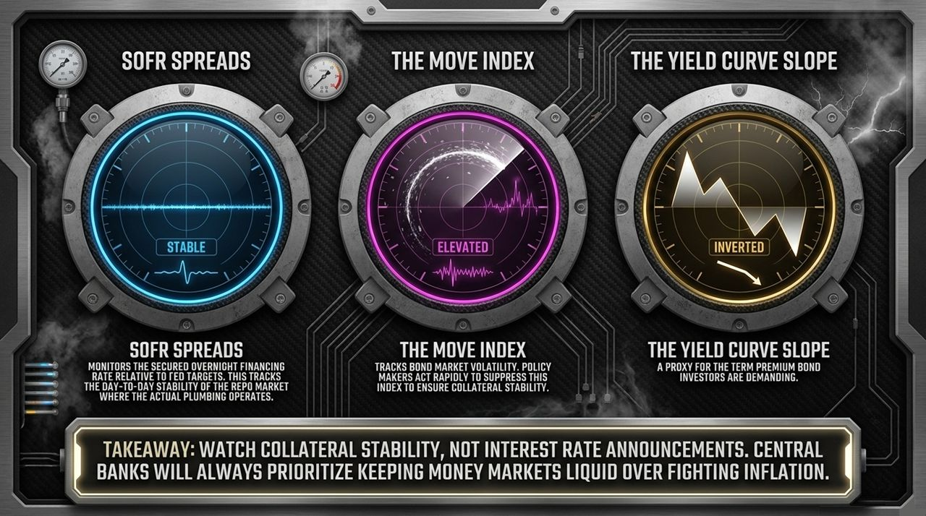
Notes:
Focus Shift: Ignore public central bank rate speeches and financial media commentary. To track the true health of global financial plumbing, monitor these three key market indicators:
Indicator 1 — SOFR Spreads (Secured Overnight Financing Rate): Monitors secured overnight funding rates relative to Fed target rates. SOFR reflects the day-to-day stability of the repo market—the core engine where collateral is exchanged for cash. Spikes in SOFR signal collateral or funding shortages in the system.
Indicator 2 — The MOVE Index: The MOVE index measures implied volatility in the US Treasury bond market. Bond volatility is dangerous because rapid price drops in Treasuries erode their value as collateral. Policy makers actively step in (via buybacks or liquidity facilities) whenever the MOVE index surges to ensure collateral stability.
Indicator 3 — The Yield Curve Slope: Reflects the term premium demanded by bond investors across maturities. An inverted or volatile curve highlights structural mismatches between short-term funding costs and long-term economic growth expectations.
Takeaway: Central banks will always prioritize keeping money markets liquid and collateral stable over fighting consumer inflation. When money markets show stress, money printing follows quickly.

Slide 10
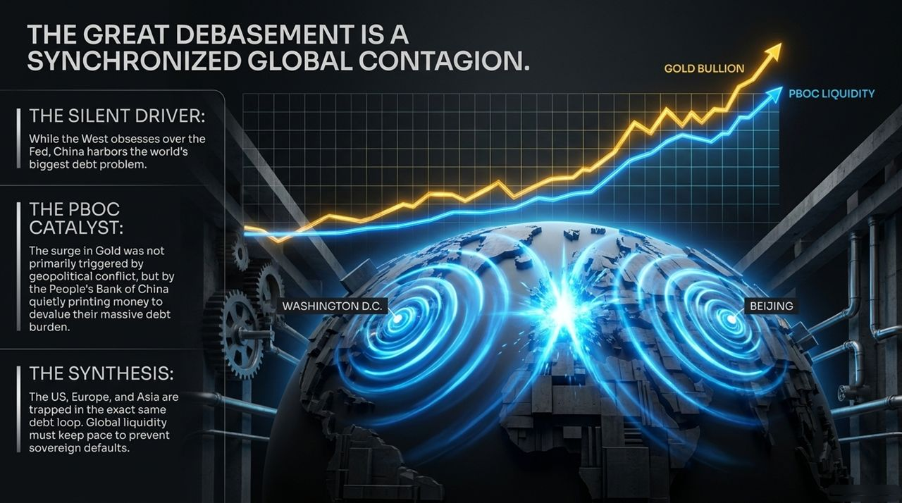
Notes:
Beyond the US: Debasement is not exclusively a US phenomenon; it is a synchronized global contagion.
The Silent Driver (China): While Western media focuses heavily on the US Federal Reserve, China harbours the world's largest total debt overhang relative to its domestic structural balance.
The PBOC Catalyst: The major rally in global Gold prices was not triggered solely by geopolitical conflicts like Ukraine; it was heavily driven by the People's Bank of China (PBOC) quietly expanding its balance sheet and injecting liquidity to devalue its internal debt burden.
Spillover Effects: China cannot afford to default on its domestic debt without destroying its banking sector. It must devalue its currency relative to hard assets. This liquidity bleeds through capital controls into global markets, driving up hard assets like Gold and Bitcoin worldwide.
The Synthesis: Western central banks (Washington D.C., Europe) and Eastern central banks (Beijing) are trapped in the exact same debt-liquidity loop. Global monetary debasement is coordinated out of structural necessity across all major sovereign nations.

Slide 11
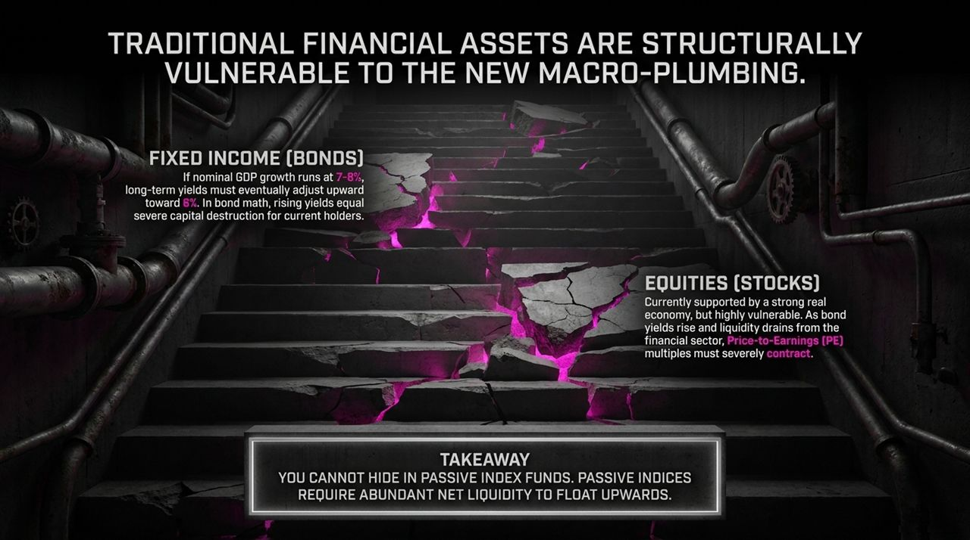
Notes:
The Trap in Traditional Portfolios: Traditional 60/40 index portfolios are structurally ill-equipped for this new macroeconomic environment.
Fixed Income (Bonds):
If nominal GDP (NGDP) growth runs at 7%–8% (driven by spending and monetary expansion), long-term bond yields must eventually adjust upward toward 5%–6%.
In bond math, rising yields cause severe capital loss for existing bondholders holding long-duration debt. Bonds no longer provide safe real returns or portfolio protection.
Equities (Stocks):
While strong nominal economic growth supports corporate earnings in the short term, equities face multiple compression. As bond yields rise and liquidity fluctuates, Price-to-Earnings (P/E) ratios compress.
Furthermore, passive index funds rely heavily on abundant net financial liquidity to float prices higher.
Takeaway: Passive index funds will underperform in an environment of elevated bond yields and monetary debasement. Investors need assets specifically designed to absorb excess monetary expansion.

Slide 12

Notes:
Empirical Data Analysis: This chart measures how different asset classes respond to a positive shock in global liquidity.
Negative Correlation (Assets to Avoid):
10-Year US Treasuries & Yield Curve Slope: These assets perform poorly during liquidity expansion. Inflationary liquidity injections drive bond yields higher, causing capital losses on existing bonds.
Moderate Correlation (Cyclical Assets):
Global Equities & Real Estate: Show positive correlation with liquidity, but remain vulnerable to rising borrowing costs, structural economic changes, and P/E multiple contraction.
Extreme Positive Correlation (Monetary Inflation Hedges):
Gold, Silver, and Cryptocurrencies (Bitcoin, Ethereum, Solana): Positioned on the far left of the sensitivity curve. These assets exhibit high beta relative to global liquidity growth.
Strategic Conclusion: Hard assets and supply-capped digital assets act as sponges for excess money creation. They capture the monetary expansion bleeding out of sovereign debt markets.

Slide 13

Notes:
The Multiplier Effect: Historical market data over the past decade reveals a clear relationship between global monetary expansion and Bitcoin's price performance.
The 10x Sensitivity: Bitcoin exhibits approximately a 10x sensitivity multiplier relative to changes in global liquidity.
Historical Elasticity: Statistically, for every 10% expansion in global liquidity, Bitcoin's price has historically doubled (~100% gain).
Why This Multiplier Exists: Unlike stocks (which depend on earnings) or real estate (which depends on physical debt), Bitcoin has a fixed supply curve. It acts as a pure, unencumbered gauge of global fiat debasement. It is directly sensitive to the stealth "Treasury QE" flooding money markets.
Portfolio Implications: Because this asset is so hyper-sensitive to liquidity, you do not need to take immense structural risk to protect your wealth. Small, controlled allocations offer outsized defense.

Slide 14
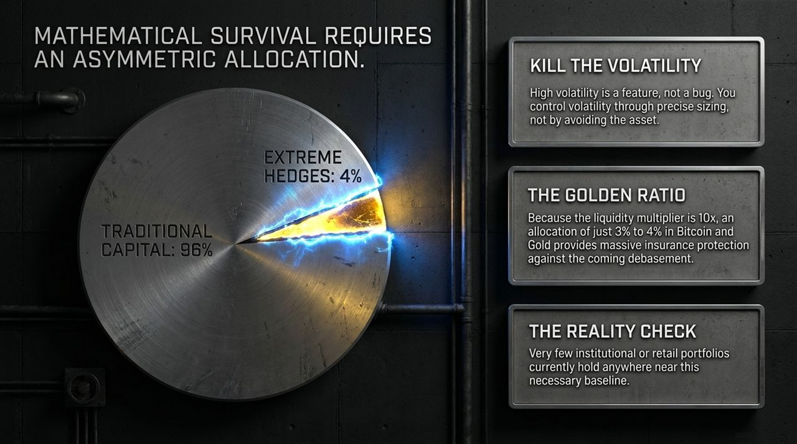
Notes:
Tackling Volatility: Investors often avoid assets like Bitcoin or Gold due to price volatility. But volatility is a feature, not a bug. You manage volatility through precise position sizing, not by avoiding the asset entirely.
The Golden Ratio Allocation:
Allocate 96% of your capital to traditional core holdings (cash equivalents, high-quality equities, or operational capital).
Allocate just 3% to 4% to extreme monetary inflation hedges (Bitcoin and Gold).
Mathematical Insurance: Because of the 10x sensitivity multiplier, a 3%–4% allocation provides sufficient asymmetric upside during debasement episodes to protect the purchasing power of the remaining 96% of your portfolio.
Institutional Mispositioning: The vast majority of retail and institutional portfolios hold far less than this 3%–4% baseline in dedicated monetary hedges. They remain exposed to currency debasement in traditional paper assets.

Slide 15

Notes:
Historical Perspective: Over the past century, fiat currency purchasing power has continually eroded. A dollar or pound sterling today buys a tiny fraction of what it bought in 1900.
Kicking the Can: Financial systems have survived by kicking the debt can down the road through monetary expansion. As Roman philosopher Cicero noted centuries ago: "Your military capacity is based on how much money you can create." Debt-driven monetary creation is an ancient playbook.
The Final Law: "When you cannot afford to default on the debt, you must devalue the money."
Conclusion & Action: Defaulting on debt would destroy the collateral foundation of the global banking system. Therefore, currency devaluation is guaranteed. The only rational response for investors is to position capital into hard, supply-capped assets that stand outside the fiat debt loop.

Slide 16
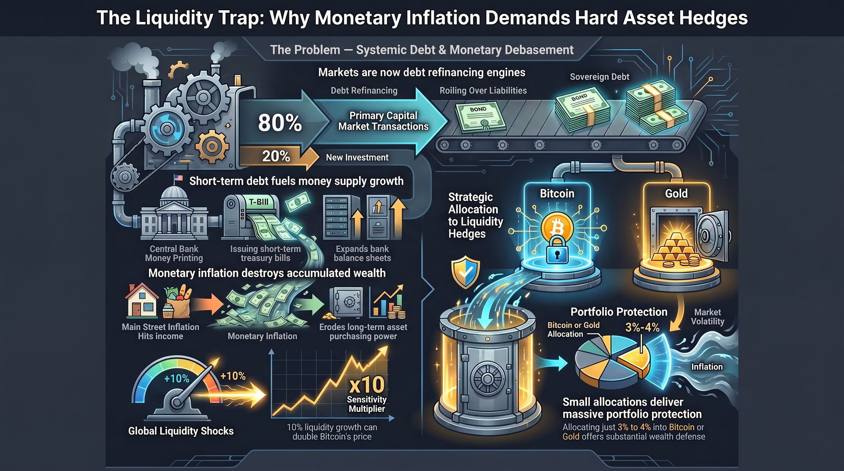
Notes:
Comprehensive Wrap-Up: Let’s summarize the complete systemic framework we have mapped out today:
1. The Debt Problem: Markets operate as refinancing engines where 80% of transactions simply roll over old debt rather than funding new innovation.
2. The Stealth Engine: Governments avoid long-term bond market crashes by issuing short-term T-Bills, driving bank balance sheet growth (M2) through stealth "Treasury QE."
3. Monetary Inflation: This constant expansion of money and credit erodes long-term purchasing power. Traditional index funds and long-term bonds are structurally vulnerable to rising yields and multiple contraction.
4. The Solution: Hard assets with fixed supply curves—Gold and Bitcoin—act as high-beta absorbers of excess global liquidity.
5. Asymmetric Protection: With a 10x sensitivity multiplier, allocating just 3% to 4% of your total portfolio to these liquidity hedges provides the defense needed to protect accumulated wealth against monetary debasement.
Final Closing: Understand the hidden plumbing, monitor money market liquidity, and position your portfolio to withstand currency debasement. Thank you.
Michael Howell: FED Rate Hikes Will Trigger The Biggest Bull Run Ever
https://www.youtube.com/watch?v=YlriydGLMPg

